Slide 1

The Adaptive Radix Tree: ARTful Indexing for Main-Memory Databases
Jonas Fritsch
Technische Universität München
Department of Informatics
Chair for database systems
Munich, 11. July 2022

Slide 2
Overview
Disk-Based vs. Main-Memory DBMS
Index-Structures in DBMS
From Tries to ART
Key Transformations for Bitwise Comparisons
Benchmarks
Summary & Conclusion
Notes:
Quick introduction of „current“ (over last decade) trend from disk-oriented to main-memory DBMS
Quick recap on usage of index-structures in DBMS
Introduction of Tries, Radix-Trees, (Judy-Arrays as first adaptive radix tree) and ART datastructure
Benchmarks comparing ART
Summary & Conclusion

Slide 3
Disk-Based vs Main-Memory DBMS
Source: OLTP through the looking glass, and what we found there. SIGMOD, 2008
Notes:
DRAM capacities large enough to fit most structured databases.
Database architecture designed for disk-based DBMS to avoid disk I/O bottleneck. (Elimination of Buffer Pool, B+-Tree Design optimized for Buffer Pool etc.)
Disk I/O bottleneck non-existent in Main-Memory DBMS -> Adaptation of database architecture
-> One needed adaptation is to used index-structures.
Graphic:
Experiment described in paper.
Taking original disk-based DBMS (Shore), placing it in Main-Memory and running TPC-C Benchmark recording time spent in major components.
(Speedup by factor 20 when stripping away/refactoring unnecessary components)

Slide 4
Index-Structures in DBMS
Data structures used to quickly find data in table via a key
2 Index-Types:
Order Preserving Indexes (Maintains keys in sorted order)
Hashing Indexes (Associative array mapping hash of key to data record. Only supports equality predicates!)
Notes:
Instead of scanning through whole table in linear time utilize index structure to locate data more quickly
B/B+-Tree as most famous Order Preserving Index example.
ART as Order Preserving Index (based on Tries)

Slide 5
Tries
Keys:
HELLO,
HAT,
HAVE
H
H
A
E
HA
HE
T
V
L
HAT
HAV
HEL
E
L
HAVE
HELL
O
HELLO
Notes:
Note: characters normally represented on edges

Slide 6
Tries – Properties
Keys:
HELLO,
HAT,
HAVE
Properties:
Height/complexity depends on key length k instead of number of elements
Require no rebalancing
All insertion orders results in same tree
Keys stored in lexicographic order
Keys are stored implicitly along paths
H
H
A
E
HA
HE
T
V
L
HAT
HAV
HEL
E
L
HAVE
HELL
O
HELLO
Notes:
Note: characters normally represented on edges

Slide 7

Tries – Implementation
Keys:
HELLO,
HAT,
HAVE
class Node {
bool is_leaf;
// ‘A‘ to ‘Z‘
Node* children[26];
}
H
H
A
E
HA
HE
T
V
L
A
Z
H
HAT
HAV
HEL
H
E
L
A
Z
E
HAVE
HELL
HA
HE
O
HELLO
Notes:
Note: characters normally represented on edges

Slide 8
Tries – Key Span, Fanout and Height
Keys:
HELLO,
HAT,
HAVE
Key Span s:
Number of bits each partial key represents (e.g. char is 8 bit span)
Fanout:
Number of children for a node
Determined by specific implementation but in general is 2^s
Height:
Max Height for k bit keys: ceil(k/s)
H
H
A
E
HA
HE
T
V
L
HAT
HAV
HEL
E
L
HAVE
HELL
O
HELLO
Notes:
Fanout with 2^Key Span can use binary representation of partial key directly as array index (no comparison but excessive memory usage)
For alphabet only fanout of 26 as only 26 different character words (a,…,z) instead of 2^8 = 256

Slide 9
Radix Trees
Keys:
HELLO,
HAT,
HAVE
H
H
H
H
OR
A
E
A
E
HA
HELLO
HA
T
V
T
V
HAT
HAVE
Tuple Pointer
Notes:
Nodes with only 1 child get merged with parent. (Vertical Compression)
„Merging“ is implementation specific:
Store edge strings in constant space with two pointers (start & end string)
Index Structure: Just omit intermediate nodes and just optimistally assume the rest of the key will match (check with tuple entry or store full key at leaf) (lazy expansion)
Will take closer look at vertical compression techniques used by art

Slide 10
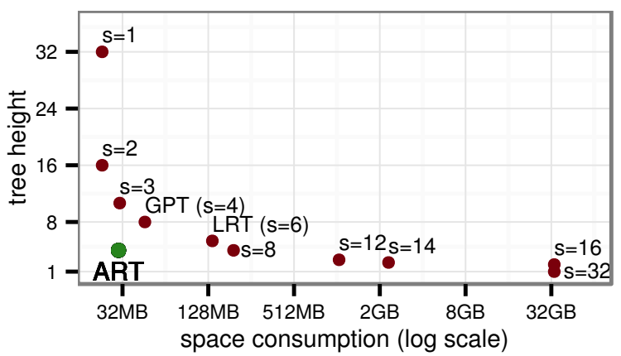
Height vs. Space Tradeoff
Source: The adaptive radix tree: ARTful indexing for main-memory databases. IEEE, 2013
Notes:
Utilize Radix Trees for vertical compression
What about horizontal compression? Size mostly dependent on fanout.
Graphic: Tree Height and space consumption for different values of the span parameter s when storing 1M uniformly distributed 32 bit integers.
General Prefix Tree (GPT): Span 4
Linux Radix Tree (used in Linux Kernel) (LRT): Span 6
ART: Span 8
How does ART manage to use so few memory with such a high span? -> Adaptive Nodes (Horizontal Compression)

Slide 11
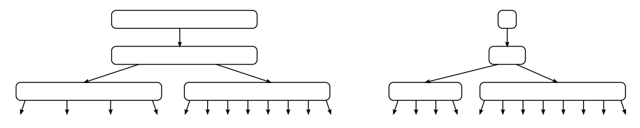
Adaptive Nodes
Main Idea:
Use different node types with different fanout based on number of non-null children.
Source: The adaptive radix tree: ARTful indexing for main-memory databases. IEEE, 2013
Notes:
First use of adaptive nodes (different fanouts) in Judy Arrays (associative array data-structure) (developed and patented in 2000 until January 2022)

Slide 12
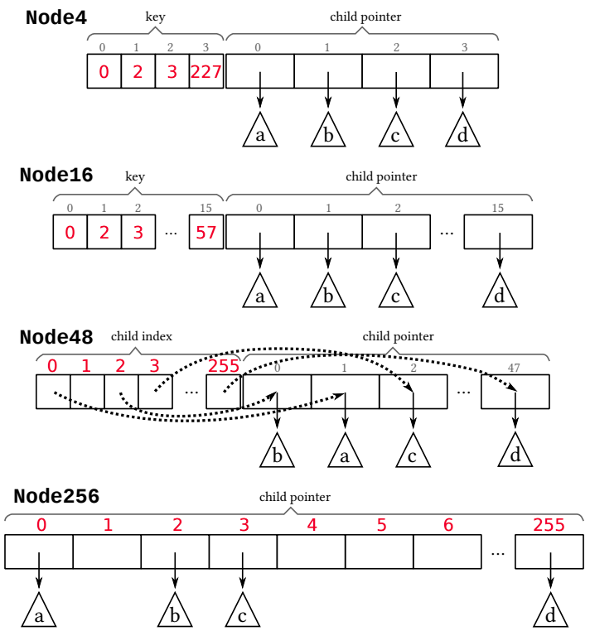
ART – Adaptive Nodes
Source: The adaptive radix tree: ARTful indexing for main-memory databases. IEEE, 2013
Notes:
ART uses 4 different node types with different capacities.

Slide 13
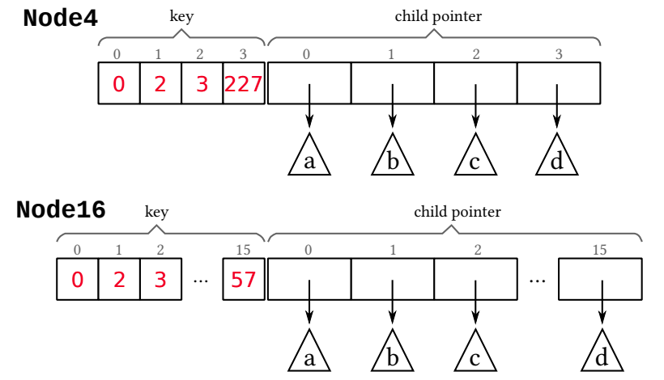
ART – Adaptive Nodes
Source: The adaptive radix tree: ARTful indexing for main-memory databases. IEEE, 2013
Notes:
Node4:
Stores up to 4 child pointers in sorted array
Index is key array is index in pointer array
Keys are sorted
Size: 16+4+4*8 = 52 Byte (16 Byte Header (see later); Cache-Line 64 Byte)
Node16:
Same as Node4 but for 5 – 16 children
Efficient key search with binary search or SIMD
Size: 16+16+16*8 = 160 Byte

Slide 14
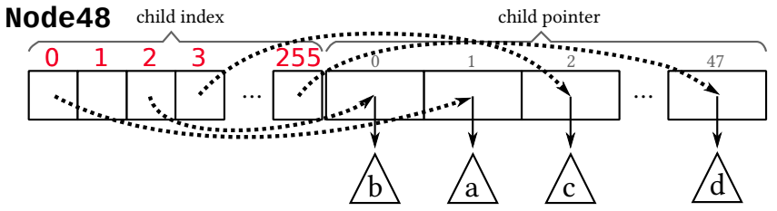
ART – Adaptive Nodes
Source: The adaptive radix tree: ARTful indexing for main-memory databases. IEEE, 2013
Notes:
Node48:
Stores 17 – 48 children
Searching for key is too expensive
-> Use partial key directly as index in index array
Index array holds index (size 1 byte) in pointer array
Size: 16+256+48*8 = 656 Byte

Slide 15
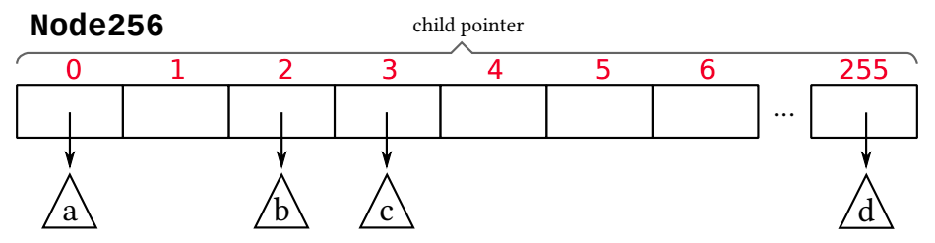
ART – Adaptive Nodes
Source: The adaptive radix tree: ARTful indexing for main-memory databases. IEEE, 2013
Notes:
Node256:
Stores 49 – 256 children
Partial key directly used as index in pointer array
Size: 16+256*8 = 2064 Byte

Slide 16
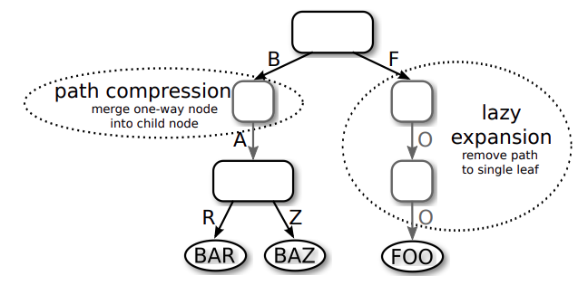
ART – Lazy Expansion
Source: The adaptive radix tree: ARTful indexing for main-memory databases. IEEE, 2013
Notes:
Only create inner nodes if required to distinguish at least 2 leaf nodes.
Need to be able to retrieve full key. Either stored at leaf with value or from database entry

Slide 17
ART – Path Compression
How to handle omitted partial key?
Pessimistic: store omitted partial key at parent node
Optimistic: only store count of omitted nodes and skip over equivalent key part (compare full key when reaching leaf)
Hybrid approach in ART:
Use pessimistic for size of up to 8 bytes for partial key. Then use optimistic.
Source: The adaptive radix tree: ARTful indexing for main-memory databases. IEEE, 2013
Notes:
Path Compression (Deletion):

Slide 18
Key Transformations for Bitwise Comparisons
How to translate attribute types to make them binary comparible?
a < b ⬄ bin(a) < bin(b) (same for > and =)
Unsigned Integers: Flip byte order for little endian machines
Signed Integers: Flip sign bit (so negative values come before positive ones), store as unsigned integer
Floats: Classify into group (neg vs. Pos, normalized vs. denomarlized, NaN, ∞, 0), store as unsigned integer
Strings: Library functions for Unicode Strings
Null: Identify special value
Compound Type: Transform each attribute separately, concatenate results
Notes:
As data must be in sorted order we need transformations such that

Slide 19
Store Attributes in Context Sensitive Way
Example: E-Mails from back to front for best compression
bob
john
ada
.com
.de
@tum
@gmail
@gmail
VS.
@gmail
@tum
.de
.com
.com
john
ada
bob
Notes:
Applies to Tries in general.
Zipfian distribution (real data is normally skewed)

Slide 20
ART – Implementation Specifics
ART implementation for storing 32 bit keys (no path compression)
Important Points:
No recursion! (self explanatory)
Careful with polymorphie! (C++ utilizes vtables for dynamic dispatch → performance + memory overhead)
Memory management! (malloc vs. TCMalloc vs. jemalloc vs. custom memory arenas/pools)
Node16 search SIMD comparison: used x86-64 SSE2
Combined value/pointer slots: Pointer Tagging using 3 low bits on 64 bit architecture (pointers are 8-byte aligned)
Source: https://github.com/atalantus/The-Adaptive-Radix-Tree/tree/main/Implementation

Slide 21
Memory Benchmark
Source: https://github.com/atalantus/The-Adaptive-Radix-Tree/tree/main/Implementation
Notes:
Trie 65k 233 MB (omitted for better scale); 16M >22 GB
ART 16M:
Dense ~ 8 Bytes per Key (similar to ART paper results)
Sparse ~ 32 BpK
Sorted List 16M:
~ 4 BpK (since 32bit integer list)

Slide 22
Memory Benchmark
Source: https://github.com/atalantus/The-Adaptive-Radix-Tree/tree/main/Implementation
Notes:
Trie 65k 233 MB (omitted for better scale); 16M >22 GB
ART 16M:
Dense ~ 8 Bytes per Key (similar to ART paper results)
Sparse ~ 32 BpK
Sorted List 16M:
~ 4 BpK (since 32bit integer list)

Slide 23
Performance Benchmark (insert)
Source: https://github.com/atalantus/The-Adaptive-Radix-Tree/tree/main/Implementation
Notes:
Trie implementation with 16M keys takes too much space to test
Sorted-List bulk insert
65k:
ART faster than Sorted List because O(log k) vs O(log n) for sorting
Other slow because of repeated hashing (see previous slide for memory consumption. Except of course dense trie 0.5 MB and only 4 array and pointer lookups each)
Sparse Trie (0.6 M i/s)
16M:
ART now slower than Sorted List because cache misses (can‘t hold all nodes in cache. Look back at memory usage for sparse 16M – previous slide)
Other slow because of cache misses/repeated hashing

Slide 24
Performance Benchmark (search)
Source: https://github.com/atalantus/The-Adaptive-Radix-Tree/tree/main/Implementation
Notes:
Trie fast for dense keys since just array and pointer lookups in cache (for sparse we get cache misses)

Slide 25
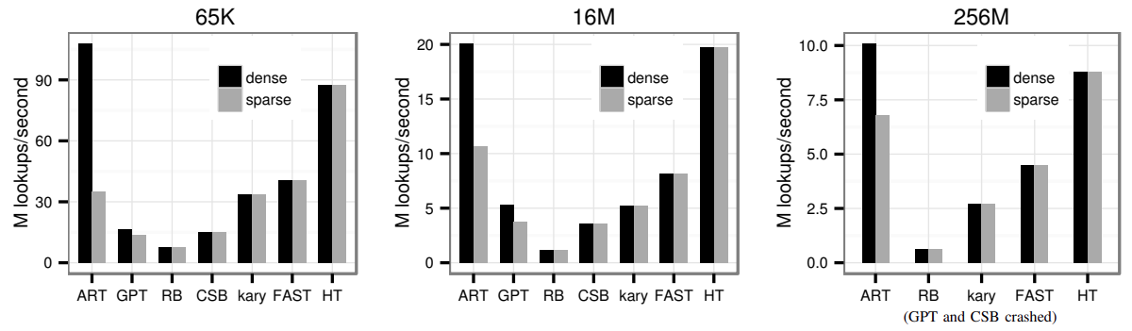
Performance Benchmark (search)
Source: The adaptive radix tree: ARTful indexing for main-memory databases. IEEE, 2013
Notes:
ART generally faster (better CPU)
ART even more competitive to Hash Table? Marmur-Hashing
CSB = Cache Sensitive B+-Tree
k-ary, FAST = don‘t support incremental updates, utilize SIMD

Slide 26
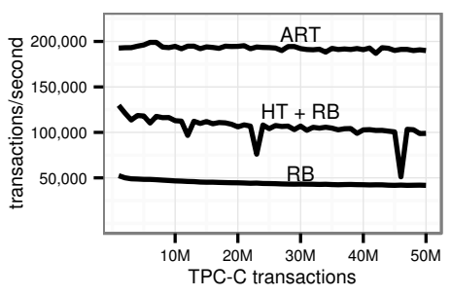
TPC-C Benchmark
Source: The adaptive radix tree: ARTful indexing for main-memory databases. IEEE, 2013

Slide 27
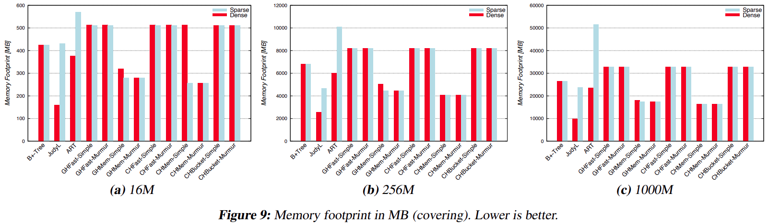
Other Benchmarks: Memory Usage
Source: A comparison of adaptive radix trees and hash tables. IEEE 2015
Notes:
GH = Quadratic Probing
CH = Cuckoo Hashing
Fast = Performance optimized
Mem = Memory optimized
Bucket = 64 Byte Buckets (for cache line usage)
Simple = Multiplicative Hash-function
Murmur = More stable but slower hash-function

Slide 28
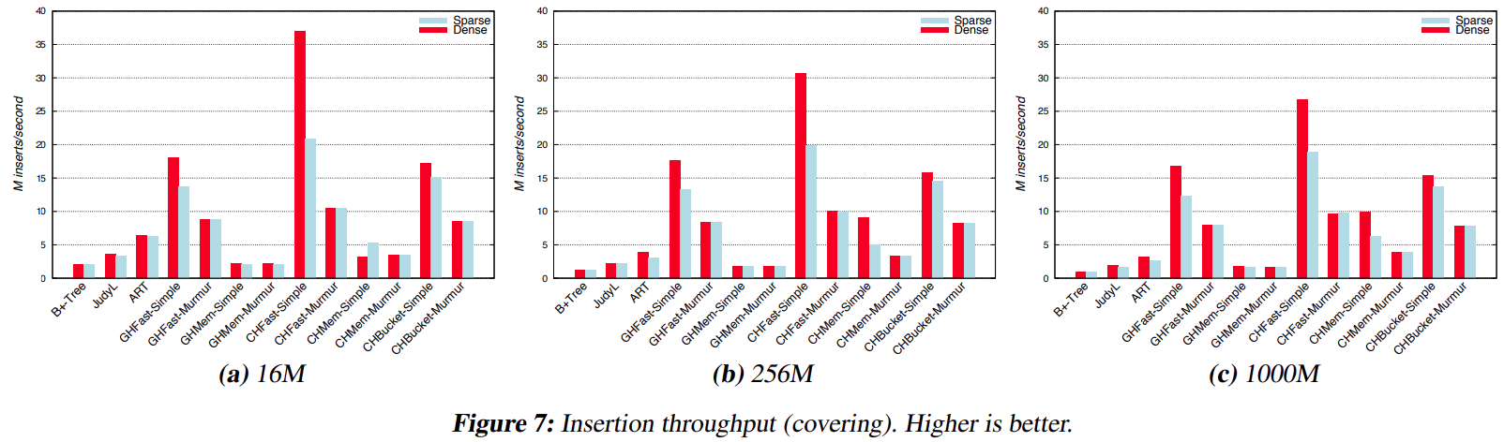
Other Benchmarks: Insert
Source: A comparison of adaptive radix trees and hash tables. IEEE 2015
Notes:
GH = Quadratic Probing
CH = Cuckoo Hashing
Fast = Performance optimized
Mem = Memory optimized
Bucket = 64 Byte Buckets (for cache line usage)
Simple = Multiplicative Hash-function
Murmur = More stable but slower hash-function

Slide 29
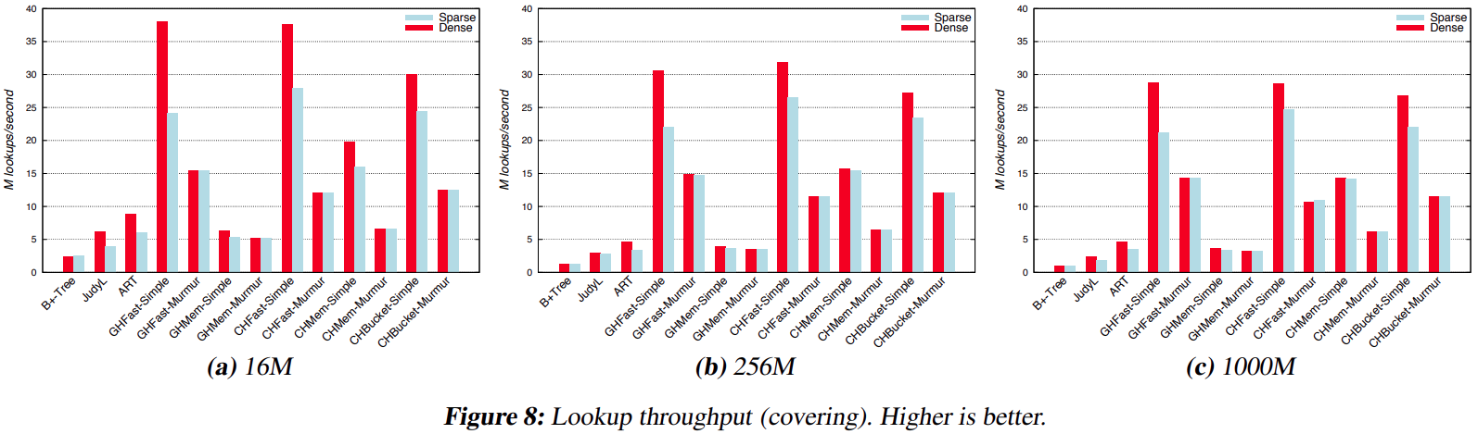
Other Benchmarks: Search
Source: A comparison of adaptive radix trees and hash tables. IEEE 2015
Notes:
GH = Quadratic Probing
CH = Cuckoo Hashing
Fast = Performance optimized
Mem = Memory optimized
Bucket = 64 Byte Buckets (for cache line usage)
Simple = Multiplicative Hash-function
Murmur = More stable but slower hash-function

Slide 30
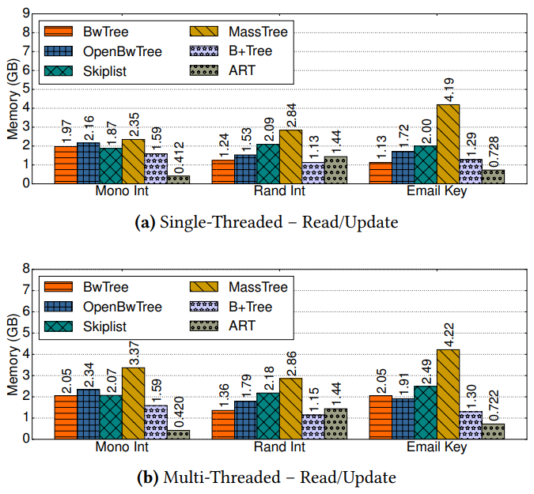
Other Benchmarks: Memory Usage
Source: Building a Bw-Tree Takes More Than Just Buzz Words. SIGMOD, 2018
Notes:
Up until now everything was single threaded!
YCSB Workload (Mono Int: 64 bit monotonically increasing integers, Rand Int …)
52M Integer Keys, 27M emails
Peak amount of memory consumption during workload

Slide 31
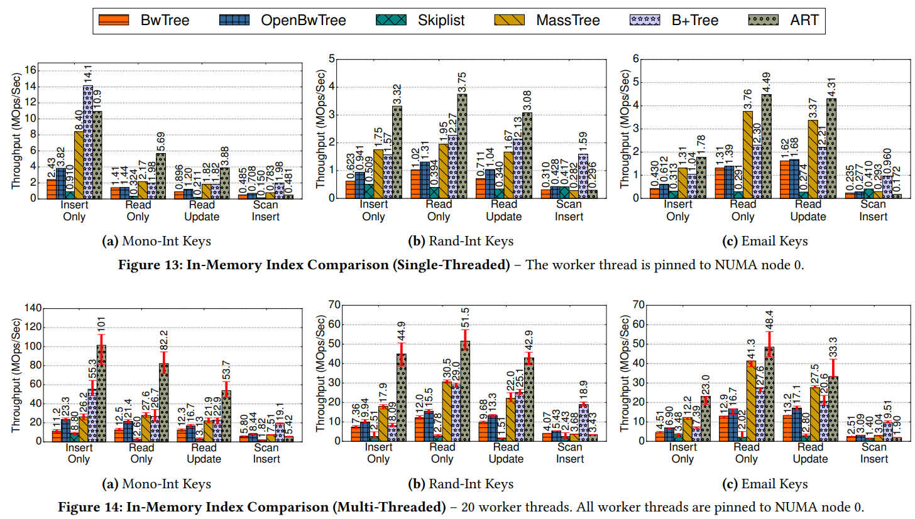
Other Benchmarks: Performance
Source: Building a Bw-Tree Takes More Than Just Buzz Words. SIGMOD, 2018
Notes:
YCSB Workload (Zipfian distribution; Mono Int: 64 bit monotonically increasing integers, Rand Int …)
52M Integer Keys, 27M emails

Slide 32
Summary & Conclusion
ART as (synchronized) order preserving index structure is
space efficient
outperforms other op-index structures in insert, search and update performance
usable for typical data types
used as default index in (at least) HyPer and DuckDB
 | Range Support | Memory Efficiency | Performance | Researched
B+-Tree | + | − | −− (best for range) | +
ART | + | ∼ | ∼ | ∼
Judy-Array | + | + | − | −
Hash-Table | − | + | ++ | ∼

Slide 33
Summary & Conclusion
Further research being done:
The ART of practical synchronization (DaMoN, 2016)
sychronize ART for multithreading using combination of OLP and ROWEX
HOT: A Height Optimized Trie Index for Main-Memory Database Systems (SIGMOD, 2018)
ART performs worse on string (more random binary distribution) due to low fanout in lower tree levels
Idea: Achieve consistently high fanout by adapting the span at each node
START – Self-Tuning Adaptive Radix Tree (IEEE, 2020)
Learned indexes outperfoming ART in read-mostly benchmark due to hierarchical structure of nodes
Idea: Optimize lower level nodes using cost model and optimizer
(Judy Arrays patent expired this year)
even better cache efficiency, complex node transitions (~20k LoC 🙃)
Judy-Pointers
Notes:
OLP = Optimistic Lock Coupling
ROWEX = Read-Optimized Write Exclusion
“Learned Indexes” utilizing machine leaning to predict data location

Slide 34
Benchmark Specs
Intel Core i5-8400 CPU @ 2.80GHz
L1 Instruction Cache: 6 x 32 KB
L1 Data Cache: 6 x 32 KB
L2 Cache: 6 x 256 KB
L3 Cache: 9 MB
16 GB DDR4 RAM
Windows 10 Pro (10.0.19044 Build 19044)

Slide 35
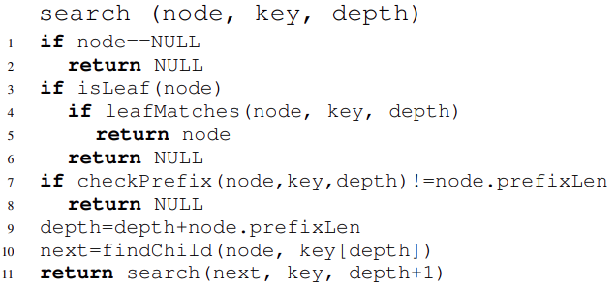
ART – Search
Source: The adaptive radix tree: ARTful indexing for main-memory databases. IEEE, 2013

Slide 36
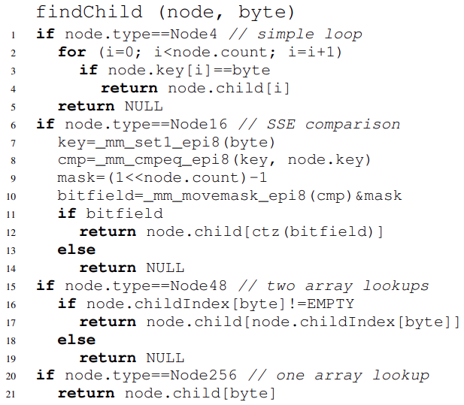
ART – Search
Source: The adaptive radix tree: ARTful indexing for main-memory databases. IEEE, 2013

Slide 37
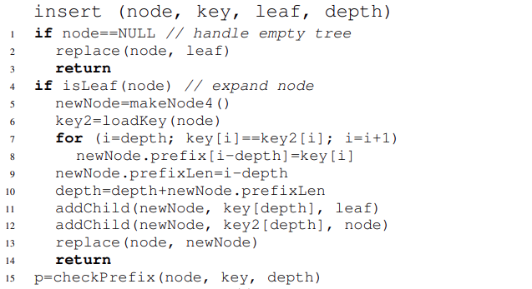
ART – Insert
Source: The adaptive radix tree: ARTful indexing for main-memory databases. IEEE, 2013

Slide 38
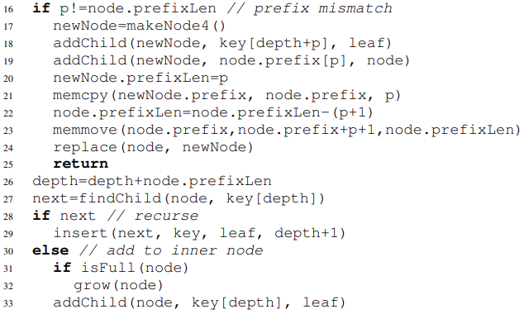
ART – Insert
Source: The adaptive radix tree: ARTful indexing for main-memory databases. IEEE, 2013

Slide 39
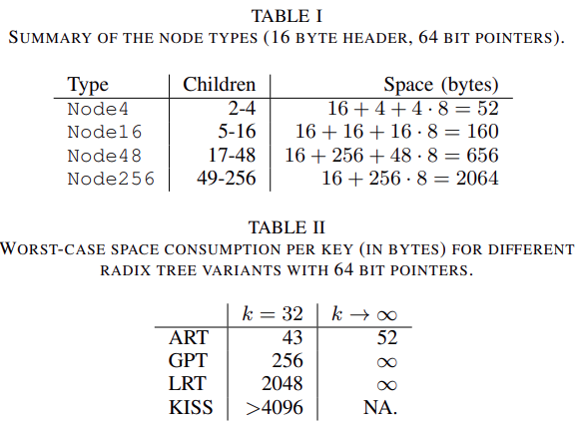
ART – Space Consumption
Source: The adaptive radix tree: ARTful indexing for main-memory databases. IEEE, 2013

Slide 40
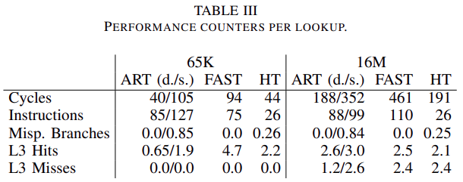
Performance-Benchmark (search)
Source: The adaptive radix tree: ARTful indexing for main-memory databases. IEEE, 2013

